Slide 1
Predicting Housing Prices
Karin Herzog & Lior Trieman

Slide 2
Competition Goal
Predict the final price of homes in Ames, Iowa based on a dataset containing 79 explanatory variables.

Slide 3
Part 1- Exploratory Data Analysis

Slide 4
Raw Dataset
79 variables: 44 categorical and 35 numerical
Target: sales price, continuous variable
Total sample size (training set): 1460

Slide 5
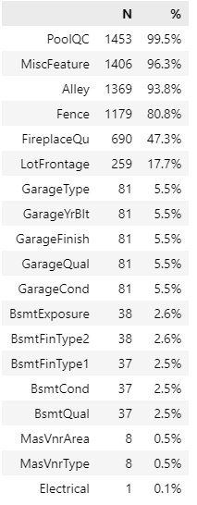
1.1 Which 3 features have the highest number of missing values (in the training set)?
PoolQC
MiscFeature
Alley

Slide 6
Evaluation of “Missing” Values Based on Data Descriptions
NA means “No” for the following categorical variables:
(i.e.: no pool, no miscellaneous features, no alley, no fence, no fireplace, no garage)
"PoolQC", "MiscFeature", "Alley", "Fence", "FireplaceQu", "GarageType"
"GarageFinish", "GarageQual", "GarageCond", "BsmtExposure", "BsmtFinType2"
"BsmtFinType1", "BsmtCond", "BsmtQual", "MasVnrType", "Electrical"
"MSZoning","Exterior1st","Exterior2nd","KitchenQual","Functional", "SaleType"
Replace missing values in the above variables with “None”
NA means “0” for the following numerical variables:
(i.e. no lot frontage, no masonry veneer area)
"LotFrontage", "MasVnrArea", "BsmtFinSF1", "BsmtFinSF2", "BsmtUnfSF",
"TotalBsmtSF","BsmtFullBath", "GarageCars"
Replace missing values in the above numerical variables with 0

Slide 7
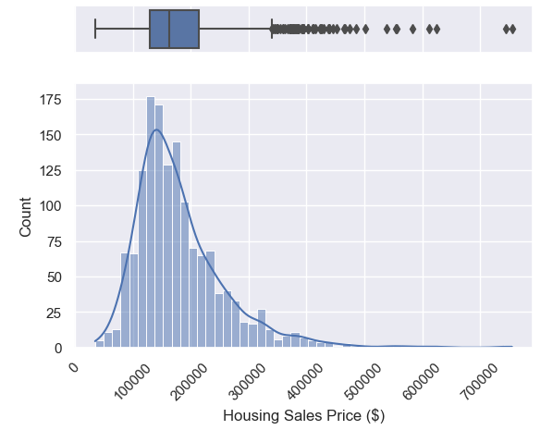
1.2 Housing Prices Descriptive Statistics
Mean Sale Price
$180,922 (SD=$79,442)
Median Sale Price
$163,000 (IQR: $129,975-$214,000)
Minimum and Maximum Sale Prices
$34,900 and $755,000, respectively
Boxplot and histogram indicate a rightly skewed distributions of housing sale prices, with outliers.

Slide 8
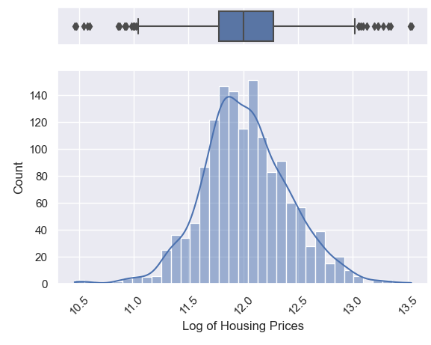
1.2 Log Housing Prices Descriptive Statistics
Boxplot and histogram are more normally distributed.

Slide 9
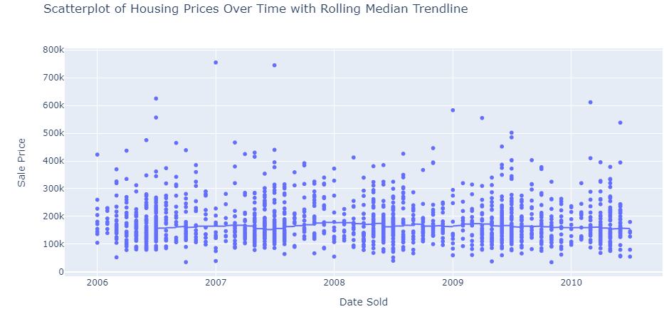
1.2 Housing Prices Trends Over Time

Slide 10
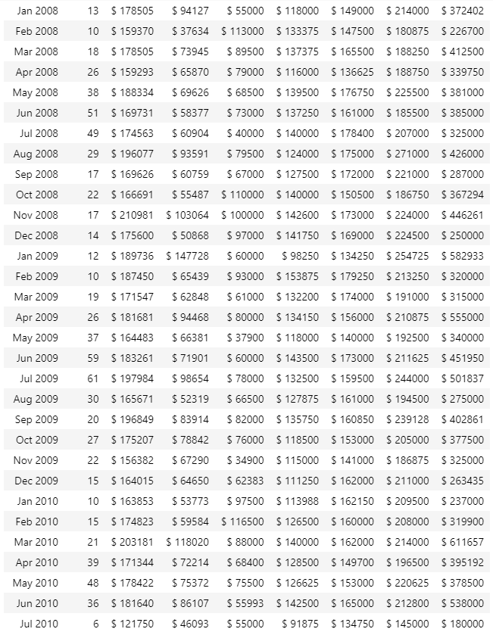
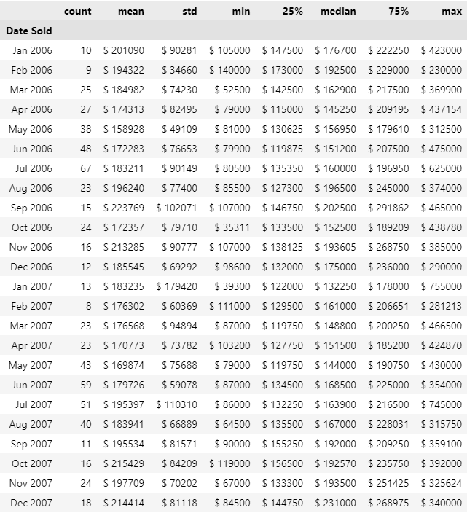
1.2 Housing Prices Over Time

Slide 11
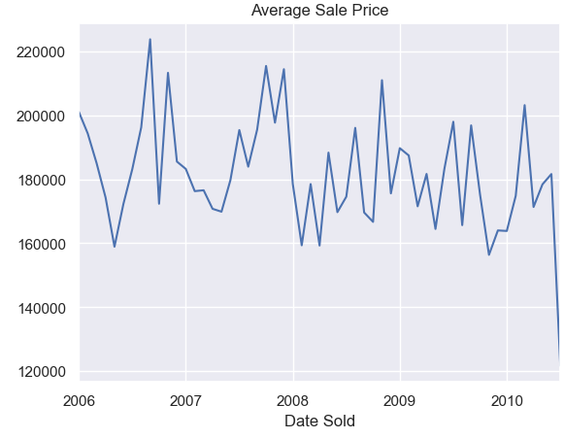
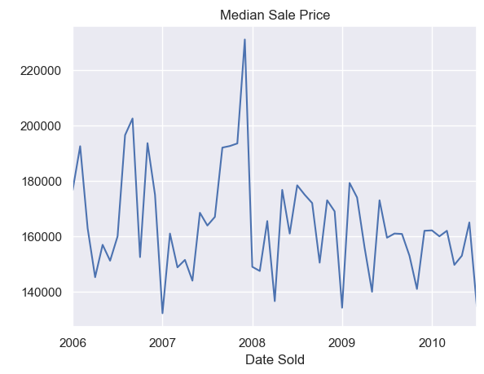
1.2 Housing Prices Trends Over Time
Peak average sales price in September 2006
Peak median sales price in December 2007

Slide 12
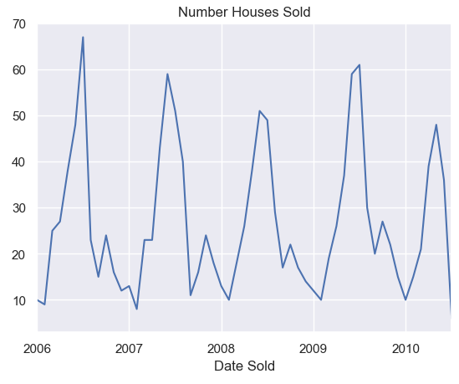
1.2 Number of Houses Sold Over Time
Visualize seasonal trends, with more houses sold in the spring/summer time

Slide 13
1.2 Summary of Housing Prices Trends
Housing prices plots and charts indicate:
Peak average sale prices in September 2006
Peak median sale prices in December 2007
Seasonal trends, with more houses sold in the spring/summer
Sharp decrease in housing prices in 2008, likely due to the 2008 financial crisis and bursting of the US housing bubble

Slide 14
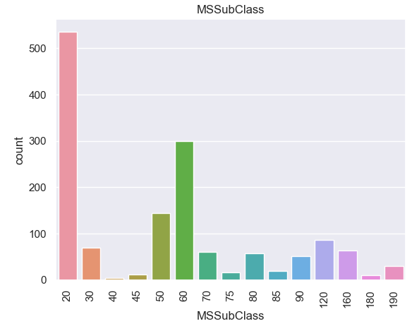
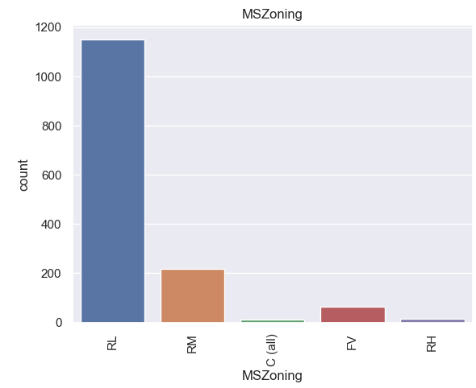
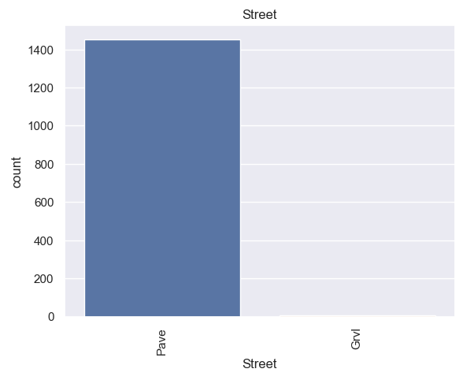
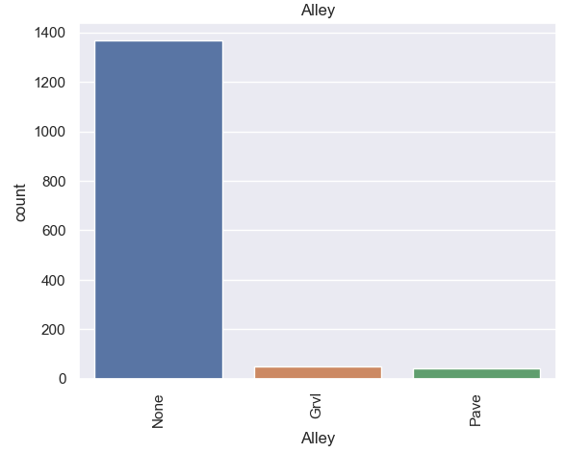
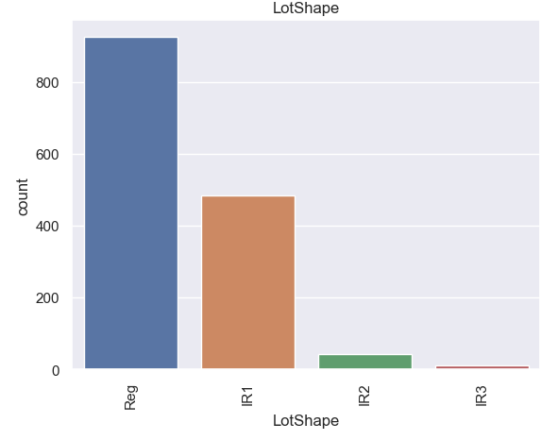
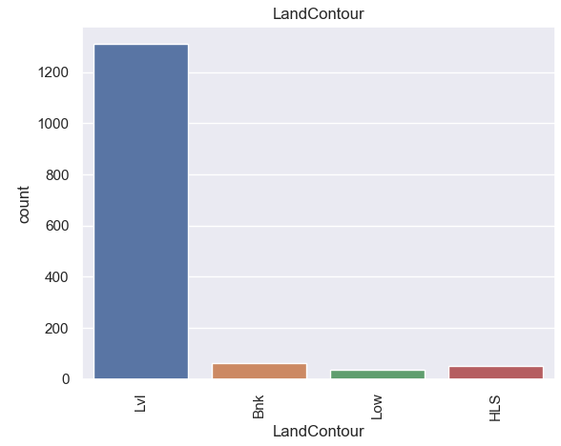
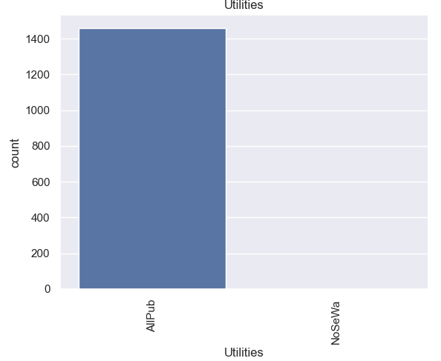
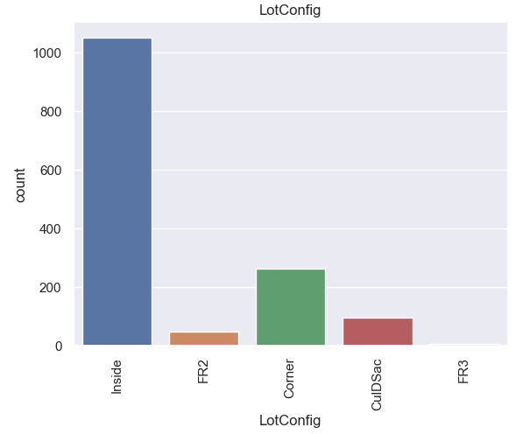
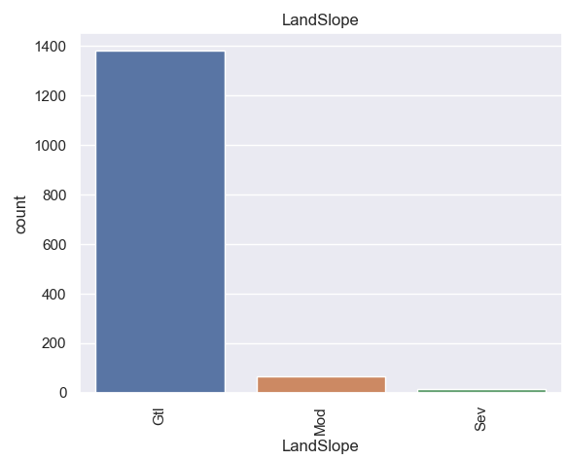
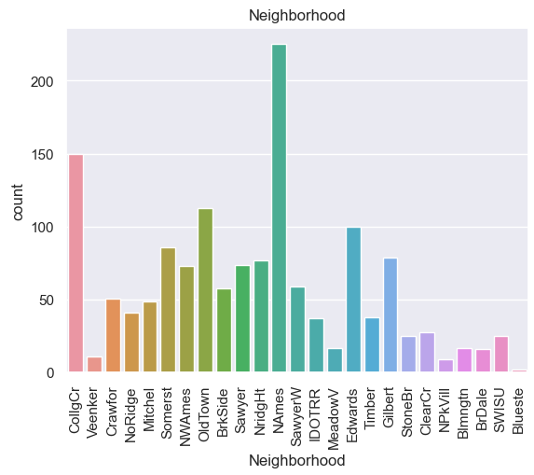
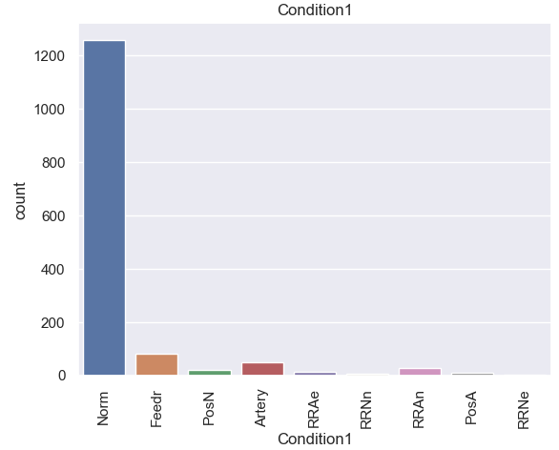
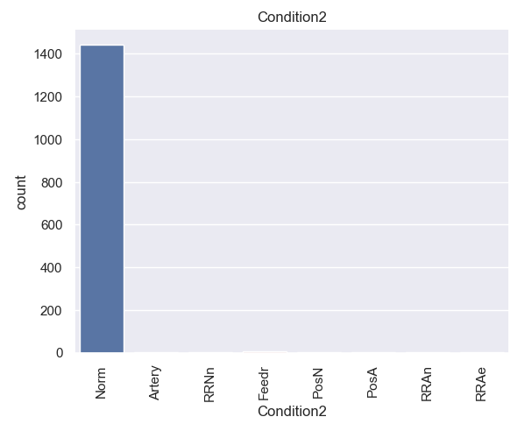
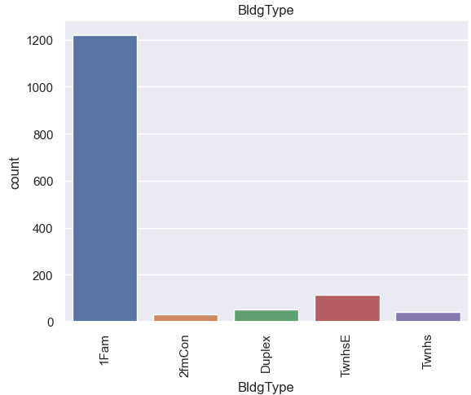
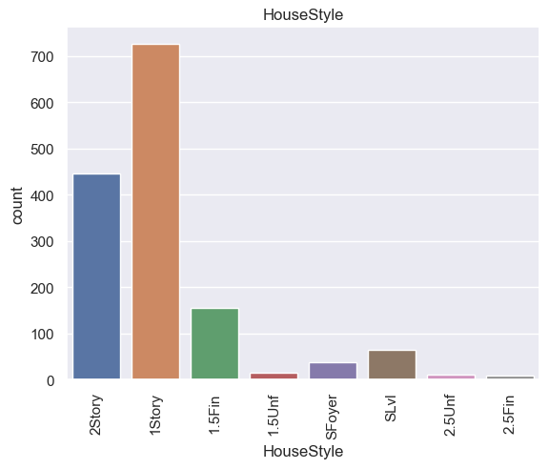
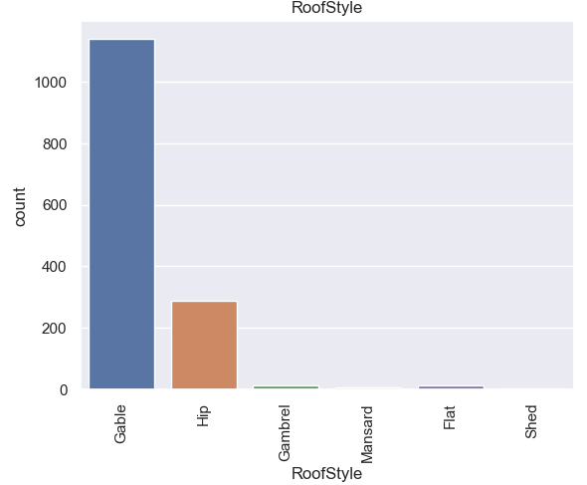
1.3 Feature Distributions: Categorical Plots of Categorical Features

Slide 15
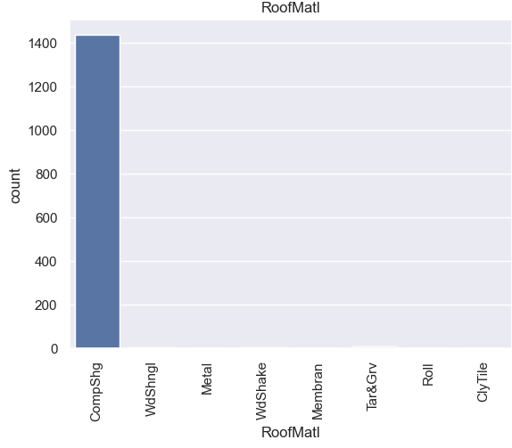
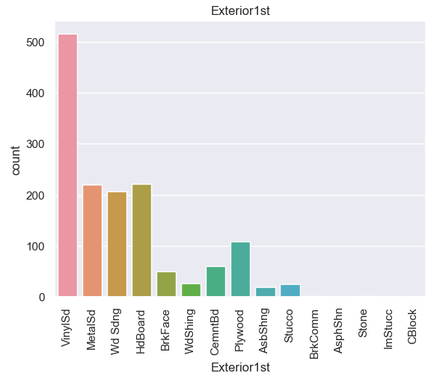
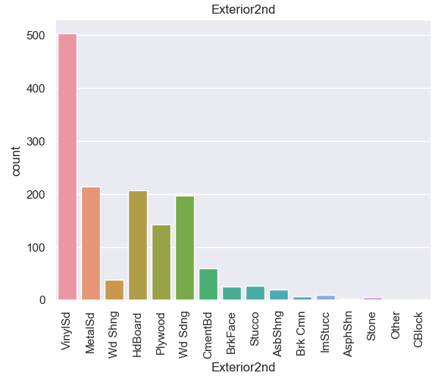
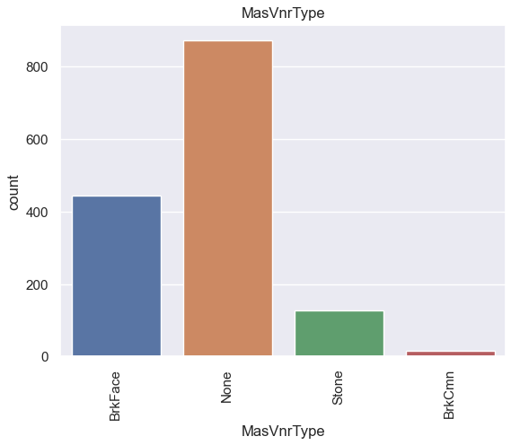
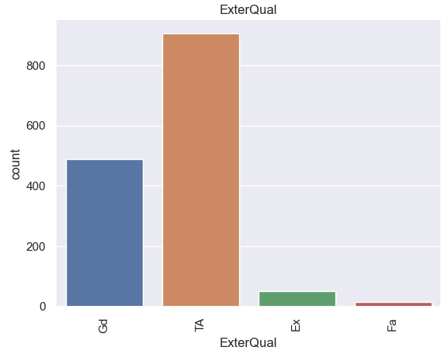
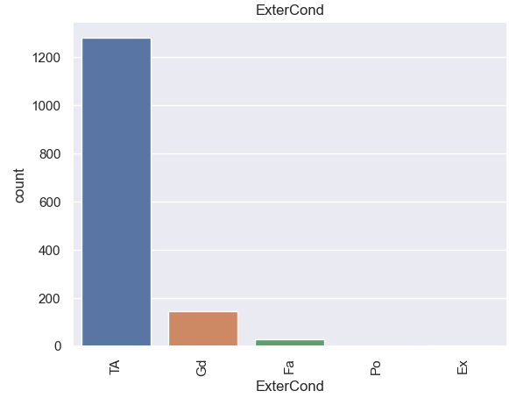
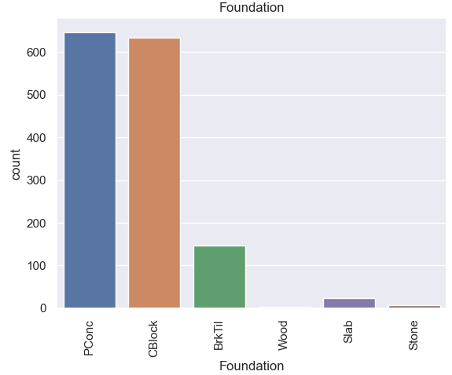
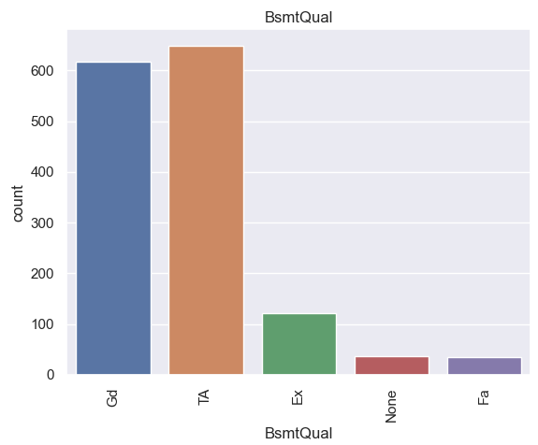
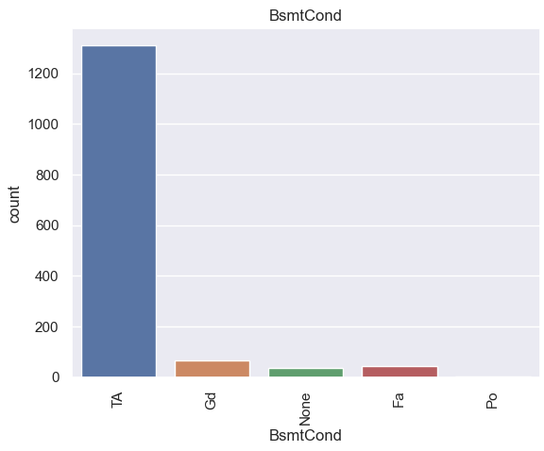
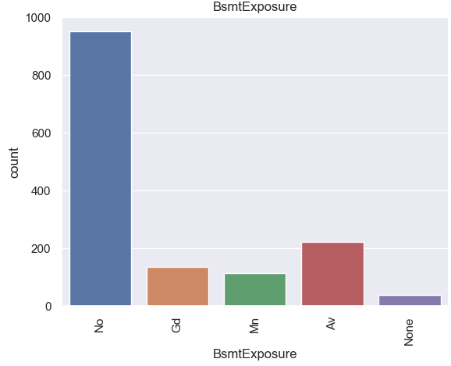
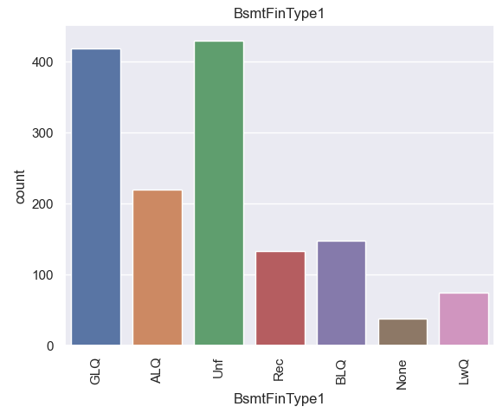
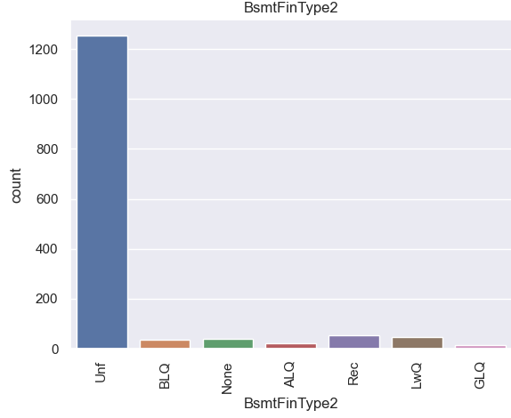
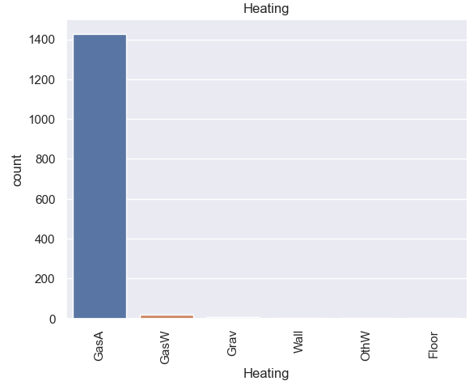
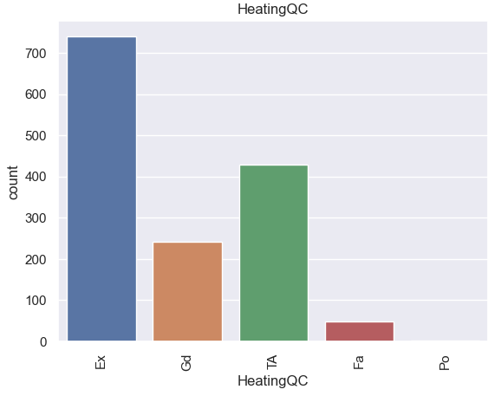
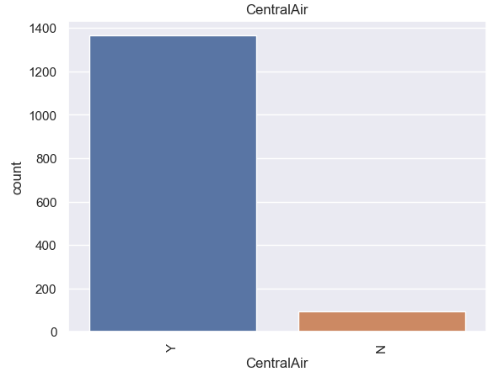
1.3 Feature Distributions: Categorical Plots of Categorical Features

Slide 16
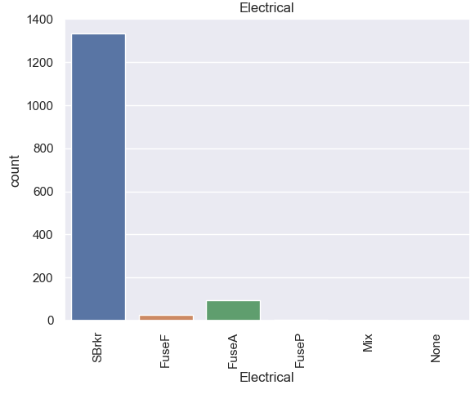
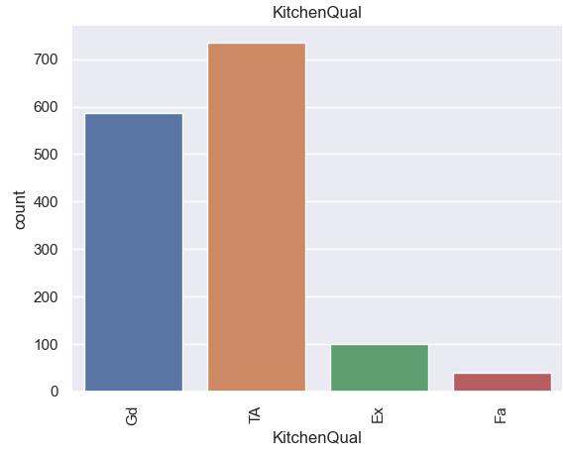
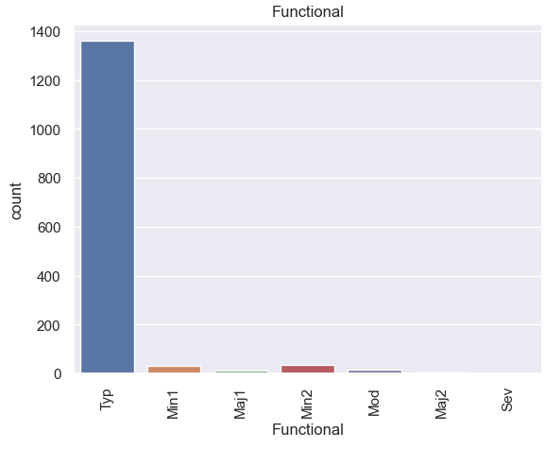
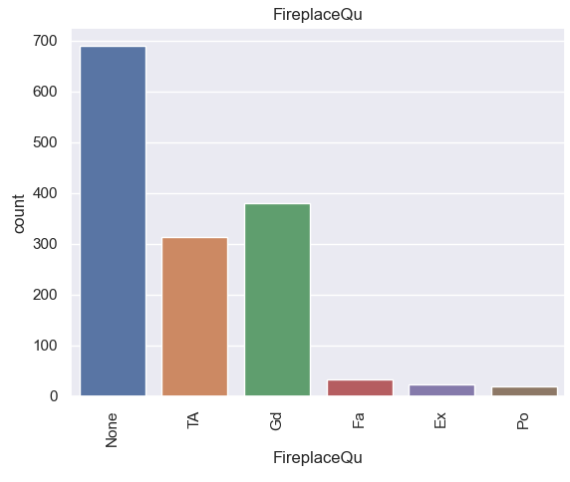
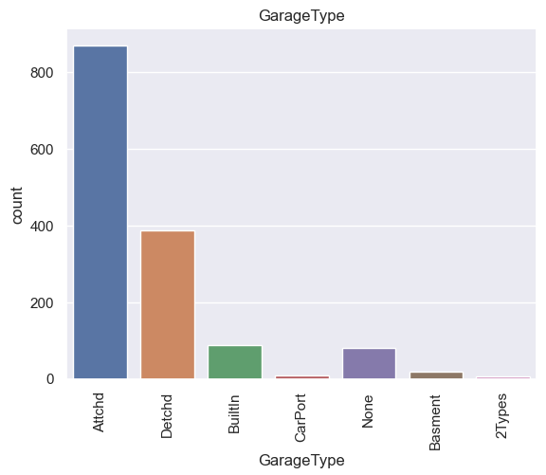
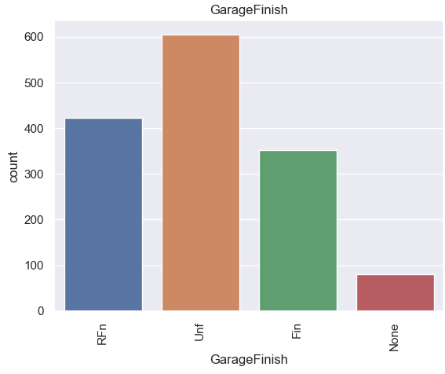
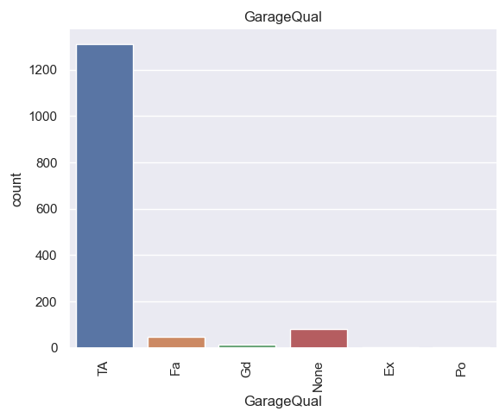
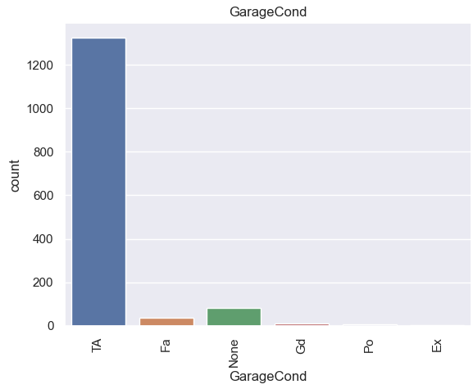
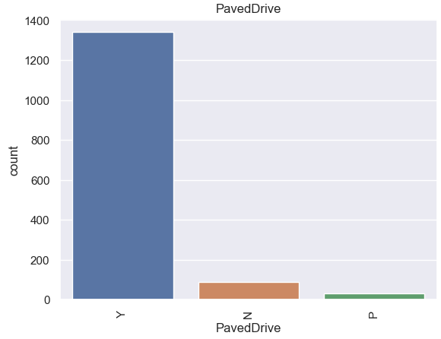
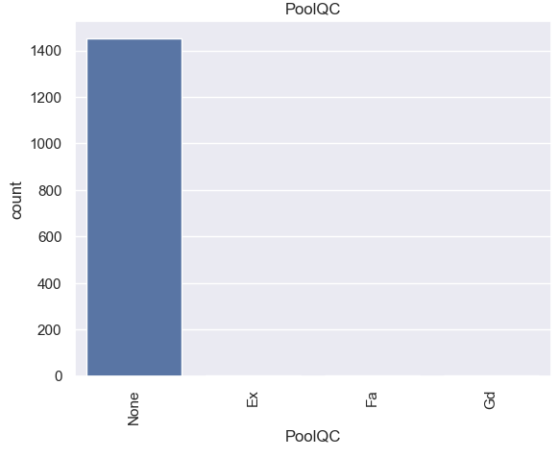
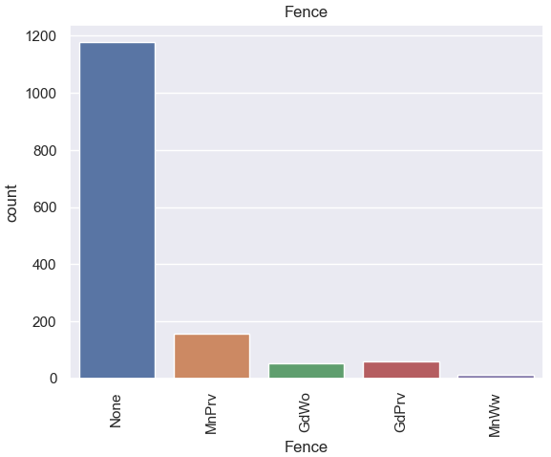



1.3 Feature Distributions: Categorical Plots of Categorical Features

Slide 17

1.3 Feature Distributions: Histograms of Numerical Features

Slide 18

1.3 Feature Distributions: Histograms of Numerical Features

Slide 19


1.4 Spearman Correlations Between Features And Sales Price
Using Spearman correlation rather than pearson correlation due to skewed distributions of the features
Five highest positive spearman correlations: OverallQual, GrLivArea, GarageCars, YearBuilt and GarageArea

Slide 20

1.5 Additional EDA: Continuous Feature Correlations
Highest Correlated Features (spearman correlations)
GarageYrBlt | YearBuilt | 0.891
GarageArea | GarageCars | 0.853
1stFlrSF | TotalBsmtSF | 0.829
TotRmsAbvGrd | GrLivArea | 0.828

Slide 21
Data Cleaning, Feature Selection & Pre-processing

Slide 22
Feature Selection
Combine MoSold and YrSold into DateSold
Compute continuous variable in months to represent date sold
Remove highly correlated continuous features (since they won’t add much information to the model)
1stFlrSF, GarageArea, GarageYrBlt, TotRmsAbvGrd
Remove categorical features with > 99% of data in only category
Street (pave: 99.59%, gravel: 0.41%)
Utilities (AllPub: 99.93%, NoSeWa 0.07%)
Recategorize features into binary form for features with one category having >= 97% of the data and other categories <3% of data:
Condition2 (Norm (98.97%) vs. all Other)
RoofMatl (CompShg (98.22%) vs. Other)
Heating (GasA (97.81%) vs. Other)
LowQualFinSF (0 vs. >=1)
3SsnPorch (0 vs. >=1)
PoolArea (0 vs. >=1)
MiscVal (0 vs. >=1)

Slide 23
Model Selection and Evaluation
Holdout: 20% (292)
Cross-validation dataset for model selection and refinement: remaining 80% (1168)
Target: log of the housing sales price
Evaluation Metric: root mean squared error (RMSE)
Perform one-hot encoding for models that don’t accept categorical types (only accept numerical types) and StandardScaler()
Perform ordinal encoding for models that accept categorical types as integers (such as Trees)

Slide 24
Part 2 - Baseline

Slide 25
Always Predict Mean or Median of the Training Set
Target: Housing Prices
 | Mean Baseline | Median Baseline
Mean CV RMSE | $78,774 | $80,424
Training RMSE | $78,842 | $80,562
Holdout RMSE | $81,671 | $83,693
Target: Log Housing Prices
 | Mean Baseline | Median Baseline
Mean CV RMSE | 0.3973 | 0.3974
Training RMSE | 0.3975 | 0.3978
Holdout RMSE | 0.4064 | 0.4069

Slide 26
Part 3 – Model Selection and Evaluation

Slide 27
 | Mean CV RMSE | Training RMSE | Holdout RMSE
Ridge Regression | $24,779 | $20,625 | $56,234
Lasso Regression | $25,033 | $21,331 | $55,276
Gradient Boosting (n_estimators=500) | $24,272 | $5,702 | $48,354
AdaBoost (n_estimators=100) | $32,174 | $25,135 | $47,083
Linear SVM (C=10000.0) | $25,362 | $22,169 | $49,639
RandomForest with one-hot encoding (n_estimators=200, max_features=1.0, min_samples_leaf=2) | $27,903 | $12,207 | $44,063
RandomForest with ordinal encoding (n_estimators=1500, max_features=sqrt, min_samples_leaf=1) | $27,042 | $9,892 | $39,329
RBF SVM (C=10000.0) | $27,047 | $1,406 | $31,776
RBF SVM with Bagging (n_estimators=500, max_samples=1.00, max_features=0.50) | $27,479 | $10,369 | $30,254
Target:
Housing Prices

Slide 28
 | Mean CV RMSE | Training RMSE | Holdout RMSE
Linear SVM (C=1) | 0.1324 | 0.0965 | 0.2387
Ridge Regression (alpha=10) | 0.1127 | 0.0950 | 0.2279
Kernel Ridge (alpha=1000, coef0=10, degree=5) | 0.1103 | 0.0798 | 0.2276
Lasso Regression (alpha=0.001) | 0.1125 | 0.1023 | 0.2254
KNeighborsRegressor(n_neighbors=3) | 0.1792 | 0.1252 | 0.2140
Stacking Model (Ridge, Lasso, RBF SVM, Random Forest, Gradient Boosting) | 0.1101 | 0.0761 | 0.2084
AdaBoost (n_estimators=100) | 0.1643 | 0.1405 | 0.1806
XGBoost (n_estimators=500, max_depth=2) | 0.1256 | 0.0384 | 0.1763
Gradient Boosting (n_estimators=500) | 0.1230 | 0.0360 | 0.1682
RandomForest with one-hot encoding (n_estimators=400, max_features=1.0, min_samples_leaf=2) | 0.1407 | 0.0624 | 0.1650
RandomForest with ordinal encoding (n_estimators=1500, max_features=sqrt, min_samples_leaf=1) | 0.1387 | 0.0504 | 0.1595
LGBM Regressor (n_estimators=500, reg_alpha=0.5, reg_lambda=0.5) | 0.1304 | 0.0444 | 0.1576
RBF SVM with Bagging (n_estimators=100, max_samples=1.00, max_features=0.50) | 0.1372 | 0.0913 | 0.1377
RBF SVM (C=0.05, epsilon=0.001) | 0.1295 | 0.0687 | 0.1293
Target:
Log Housing Prices

Slide 29

Hyperparameter Tuning of RBF SVM Model
Lowest Holdout RMSE: 0.1287
C=0.3
Epsilon=0.001

Slide 30
Summary and Discussion
A data set of 44 categorical features and 35 numerical features was received in order of predict house prices (supervised regression problem)
Initial EDA was performed to get the know the data, and where we have missing values/unbalanced data and correlation between the features
The data was preprocess (filling missing values/standardization/log transformation etc) – target was log transformed
A baseline of linear regression model was applied using 3 algorithms: OLS,Ridge, Lasso
All models showed low training error and high validation error meaning overfitted.
Additional models were tried, and a grid search for the hyperparameter tuning of each model was performed. Evaluation score was RMSE

Slide 31
Summary and Discussion Cont.
The data set was divided for validation purposes.
5 fold cross validation was performed
The mean RMSE, training RSME and Holdout RSME were calculated.
The best model was chosen according to best scores: RBF SVR
The cons of this algorithm is that it is not good at scaling (>10K data points)

Slide 32


Slide 33
Thank you
Lior Trieman Linkedin
Karin Herzog Linkedin

